Slide 1


Find the middle of the incoming array/slice
Sort the LEFT side
Sort the RIGHT side
Merge the LEFT & RIGHT side
Array/Slice of 1 element is considered sorted
Repeat the process using divide & conquer
L
6
2
1
5
3
4
R
1
2
6
1
2
6
1
2
3
4
5
6
3

Slide 2
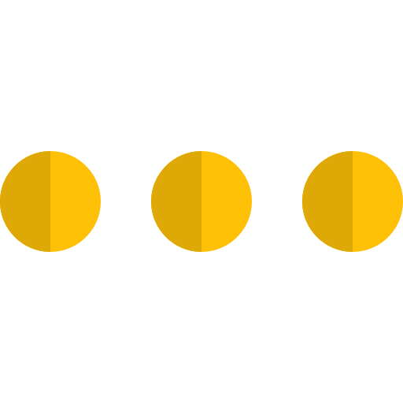
Divide a problem into smaller problems of the same type
Repeat the process till the problem cannot be divided
Collect & merge indivisible problems (solutions) (Conquer)
6
2
1
5
3
4
6
2
1
5
3
4
1
2
6
1
2
6
1
2
3
4
5
6

Slide 3
The algorithm
We need a merge & a sort function
Split the slice in 2 sides
Call sort recursively on the Left side
Call sort recursively on the Right side
Call merge recursively for Left & Right side
Return the sorted merged slice

Slide 4





0
1
2
0
1
2
4
5
7
1
3
6
L
4
5
7
R
1
3
6
i
j
0
1
2
3
4
5
A
1
3
4
5
6
7

Slide 5

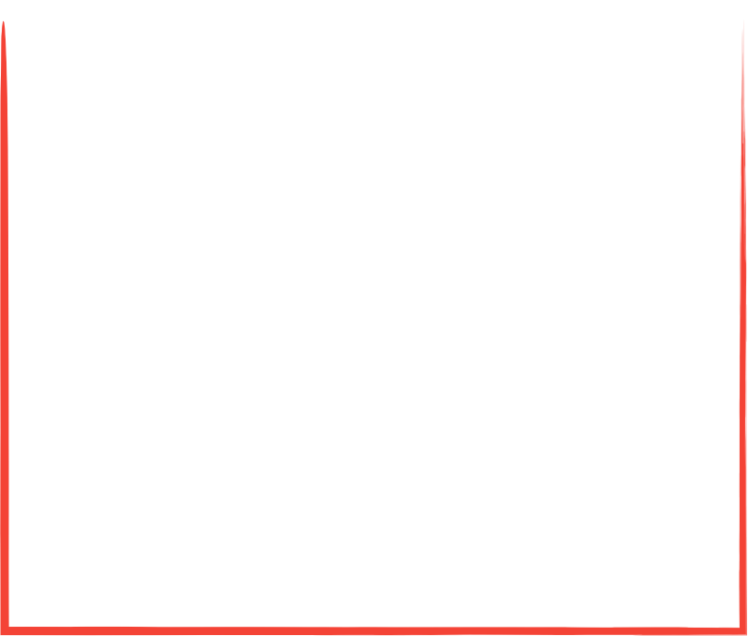
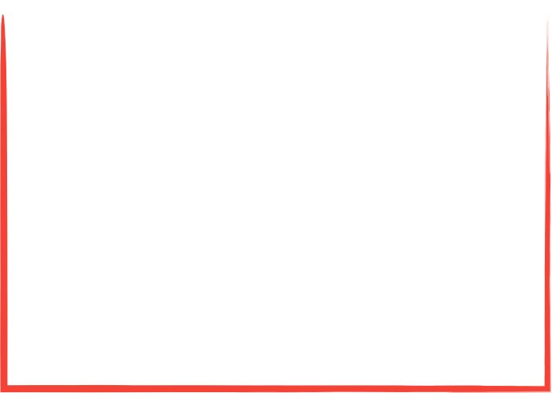
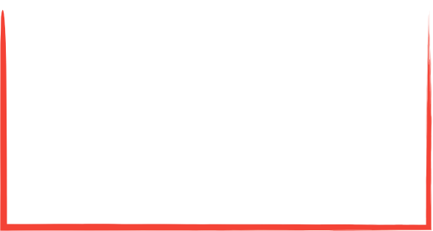

A := []int{6,2,1,3,5,4})
sort(R)
sort
sort([]int{6,2,1,3,5,4})
1
2
3
4
5
6
6, 2, 1, 3, 5, 4
sort(A)
merge(sort(L), sort(R))
sort([]int{6,2,1})
sort(L)
sort(R)
sort([]int{2,1})
sort
merge
sort
merge([]int{2}, []int{1})
6, 2, 1
3, 5, 4
1
2
6
3
4
5
merge(sort(L), sort(R))
merge([]int{6}, []int{1,2})
merge
sort(L)
sort(L)
sort([]int{3,5,4})
merge
sort
merge
sort
sort([]int{5,4})
6
2, 1
5, 4
1
2
3
4
5
merge
merge([]int{5}, []int{4})
merge([]int{3}, []int{4,5})
merge
merge
merge(L, R)
merge([]int{1,2,6}, []int{3,4,5})
2
1
5
4

Slide 6
function merge(L, R) {
let A[0..L.length+R.length]
i, j, k = 0, 0, 0
while i < L.length and j < R.length {
if L[i] < R[j] {
A[k] = L[i]; i++
} else {
A[k] = R[j]; j++
}
}
while i < L.length {
A[k] = L[i]; i++; k++
}
while j < R.length {
A[k] = L[j]; j++; k++
}
return A }

Slide 7
function sort(A) {
if A.length > 1 {
n1 = A.length/2
n2 = A.length-n1
let L[0..n1] and R[0..n2]
for i=0 to n1
L[i] = A[i]
for j=0 to n2
R[j] = A[n1+j]
A = merge(sort(R), sort(L)) }
return A }
m = A.length/2
L = A[:m]
R = A[m:]

Slide 8
IMPROVEMENTS
Merge sort uses temporary memory (L, R slices) (problem for big data sets)
Merge sort works nicely on big data sets & is stable & predictable
Insertion sort is faster for small data sets
Insertion sort does not use temporary memory

Slide 9
Insertion merge sort
Use merge sort mostly
Check data length before splitting the array/slice
Use insertion sort if the data length is small enough

Slide 10
Facts
Merge Sort is Efficient & Very Fast for big data sets
Merge Sort Time Complexity: O(n log(n))
Merge Sort: Space Complexity: O(n)
Insertion Sort is Efficient for small data
Insertion Sort Best: O(n)
Insertion Sort Average/Worst: O(n*n)
Insertion Sort: Space Complexity: O(1)

